Slide 1
History of the modern age

Slide 2
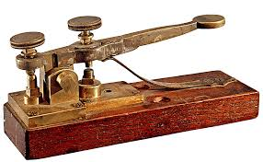
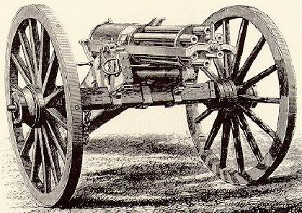
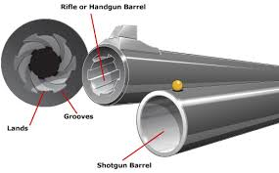
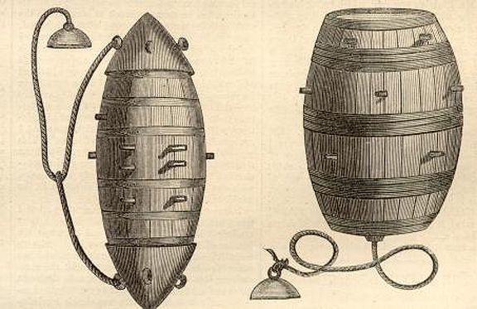
Inventions of The civil WAR
The Telegraph- The beginning of the telephone, 15000 miles of wire across the coast of the us for military purposes.
Rail roads- The railroads were first utilized for military purposes during the civil war. President Lincoln encouraged the use of railroads.
Long range weapons- before the civil war, most militaries used a musket which had a maximum range of 300 ft but before the start of the civil war they started rifling which would increase the range up to 900ft.
The Gatling gun- originally created to convince men to stop waging war because of how catastrophic it was. But it had the reverse effect and was used through the civil war and after.
Torpedoes and naval mines- the south created the naval mine to counteract the blockades of the north. This led to the creation of torpedoes. The success of torpedoes and naval mines led to the invention of grenades and land mines used in later wars.

Slide 3
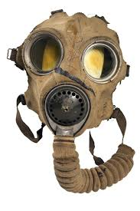
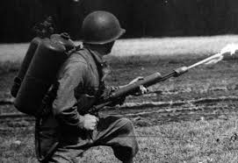
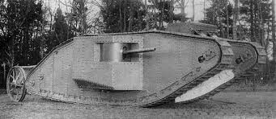
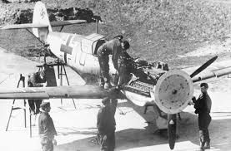
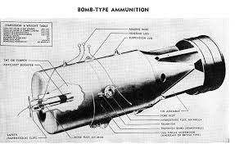
Inventions of WWI
Tanks: Walter Gordon Wilson and William Tritton invented the Mark 1 tank in 1915 and first saw action in 1916 and changed how the war was fought regarding "No Man's Land"
Flamethrowers: Invented by Richard Fielder in 1901 and first saw military action in 1911 which changed how troops fought within the trenches.
Interrupter Gear: Invented by Franz Schneider, or Anthony Fokker and was used to have machine guns shoot out of the plane with increased accuracy
Depth Charges: Produced by the Royal Navy's Torpedo and Mine School in 1916 and was used to attack the German U-Boats that were terrorizing the allied aircraft
Hydrophones: Invented in 1914 by Reginald Fessenden, and improved by Paul Langevin, and Constantin Chilowsky and was used to determine the distance and direction of U-Boats
Gas Mask: Garett Morgan invented the Gas Mask in order to combat the use of chemicals in trench warfare.

Slide 4
WWII
Top inventions and technical innovations of World War 2.
Radio navigation and landing.In order to help the crews, several navigation systems were created For accurate blind bombing, the systems Oboe and Gee-H (radio-based systems) were used, although these could only be used by a very number of planes at once.
Penicillin.. World War II saw major advances in medical technology including the mass production of penicillin. On March 14, 1942, U.S. made-penicillin was used to successfully treat the first patient for septicemia, or blood poisoning.
synthetic rubber and oil. When the natural rubber supply from Southeast Asia was cut off at the beginning of World War II, the United States and its allies faced the loss of a strategic material. With U.S. government sponsorship, a consortium of companies involved in rubber research and production united in a unique spirit of technical cooperation and dedication to produce a general purpose synthetic rubber, GR-S (Government Rubber-Styrene)
Radar.
V-2 (space travel) and jet engines.
The Manhattan project atomic bomb

Slide 5
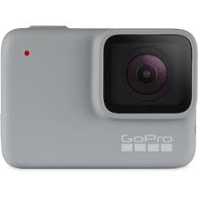
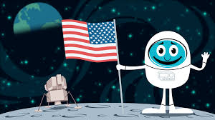
Inventions of the Cold war
Portable cameras/ recording devices- these devices were largely spread for the use of espionage amongst spies and military personnel.
The ARPAnet- a network of communications widely used by the military across the US on servers to help protect against nuclear war.
Nuclear power- a result of the mass production of nuclear weapons. A highly efficient yet wasteful source of energy.
Space tech- the government dumped billions of dollars into the space programs, mostly for military purposes. This would allow them to place satellites for surveillance strategically.

Slide 6
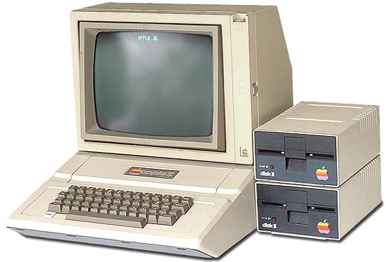
Inventions during the Baby Boomer
•DNA Fingerprinting- Invented in 1950 by Sir Alec Jefferies. Without this t
•Apple II-Created by Steve Jobs in 1955 which is known as "the most personal Computer"
•The World Wide Web-
Free shipping- invented in 1964 by Sir Tim Berners Lee. Without him there would be no Amazon prime
The Universal Service Port(AKA USB)- Invented by Ajay Bhatt without this there would be a lot of memory loss literally and figuratively
The Ethernet cable- Born by Robert Metcalfe in 1946 helps with connections to the internet

Slide 7
Biblography
http://mentalfloss.com/article/31882/12-technological-advancements-world-war-ito add text

